Slide 1
Parameters

Slide 2
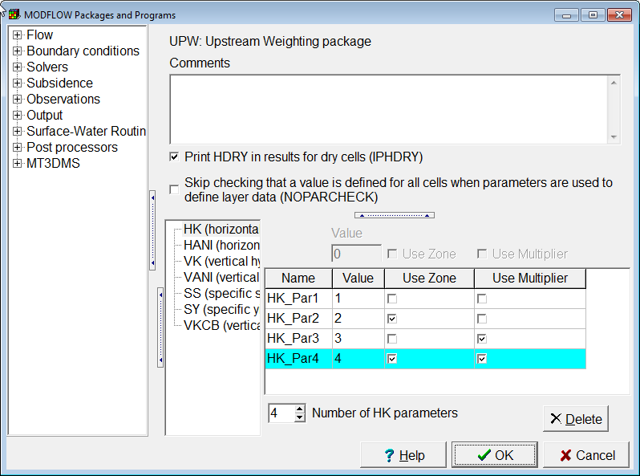
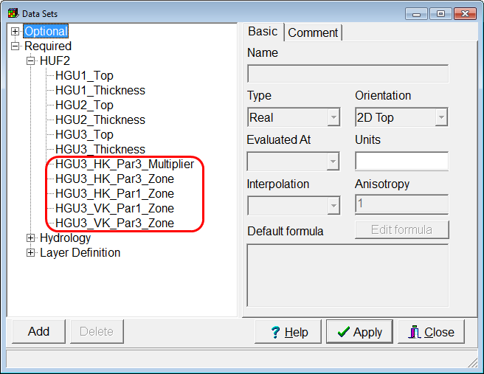
Defining Parameters
Parameters with Zone and Multiplier Arrays
3D Data Sets for Zone and Multiplier Arrays

Slide 3
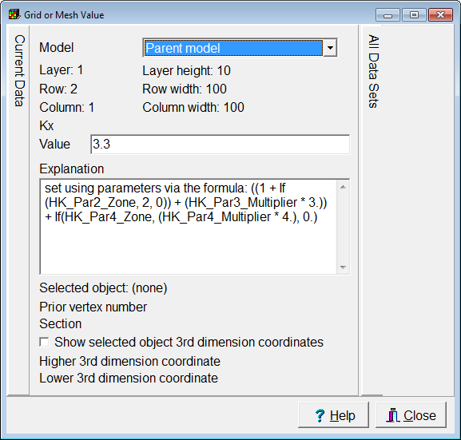
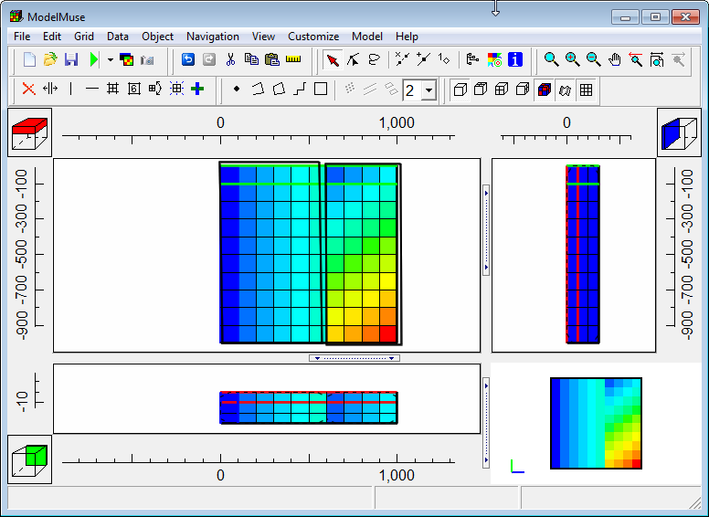
ModelMuse can Display the Combined Effects of the Parameters

Slide 4
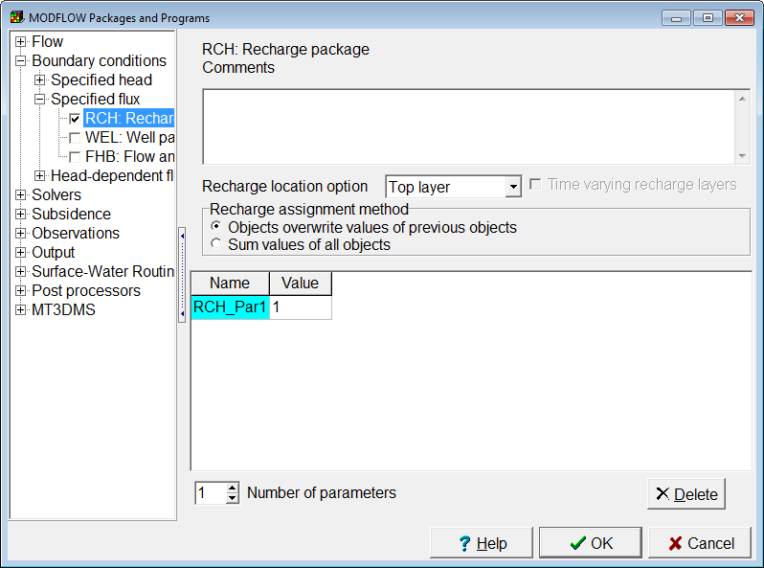
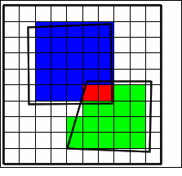
Recharge and ET
No individual data sets for Zone and multiplier arrays
Zone and multiplier arrays are defined by objects.
Overlapping Parameters are added together.

Slide 5
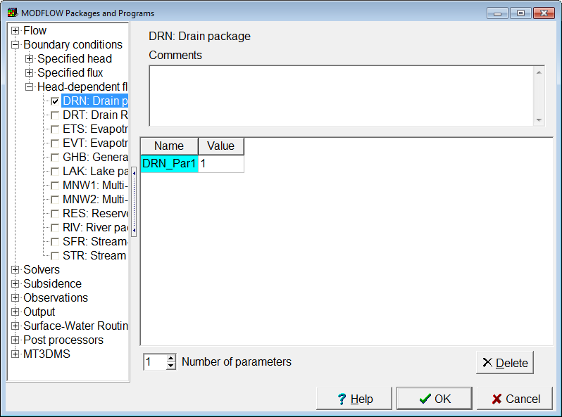
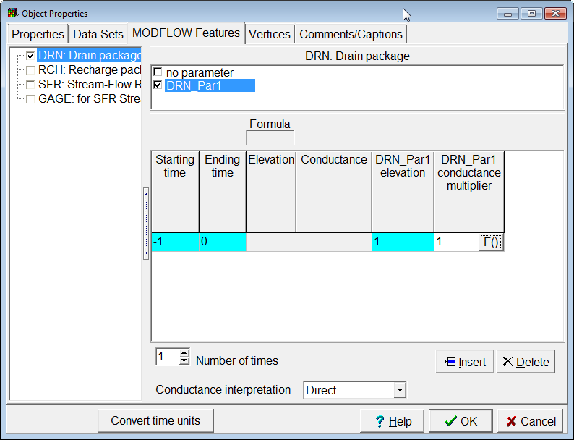
Parameters for List-Based Boundaries Defined by Objects

Slide 6
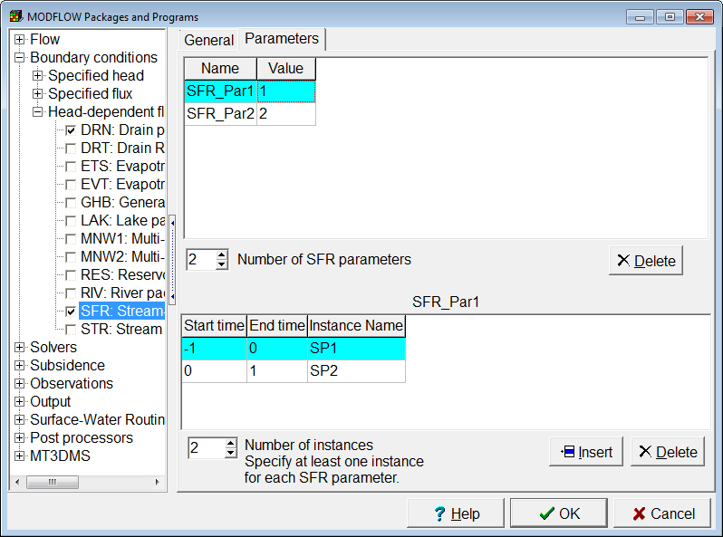
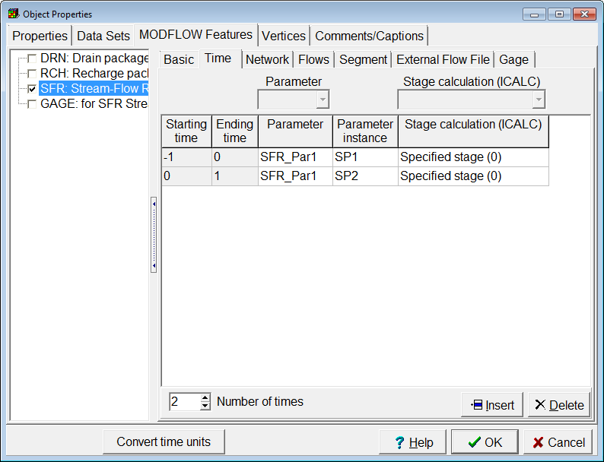
SFR Package
For SFR, you must define both parameters and instances. Then select them in an object.

Slide 7
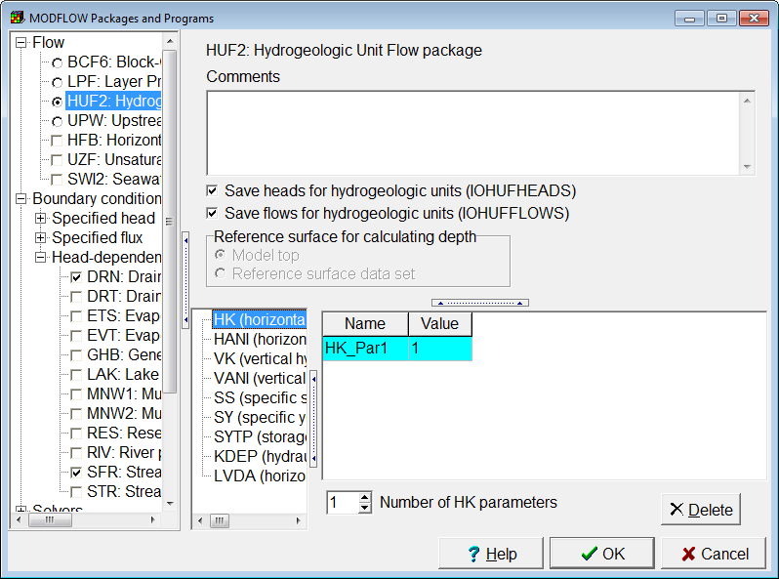
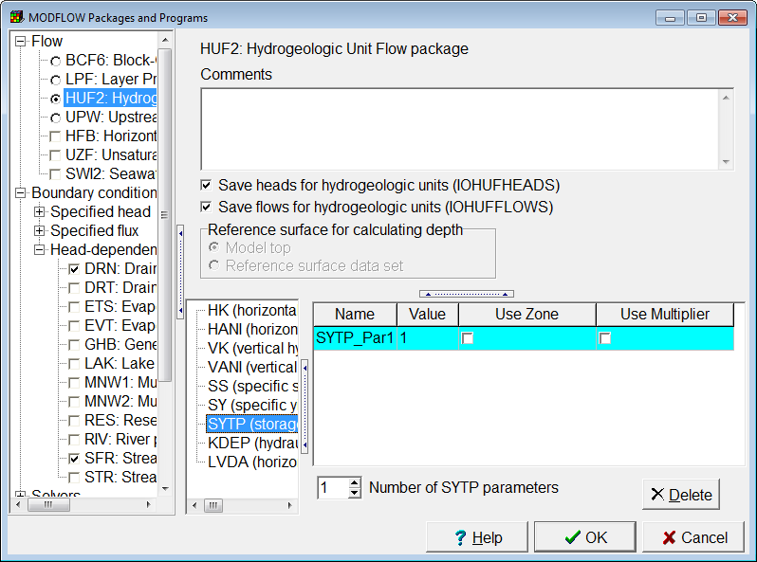
Hydrogeologic Unit Flow Package
Some parameters apply to individual geologic units
Some parameters apply more broadly

Slide 8
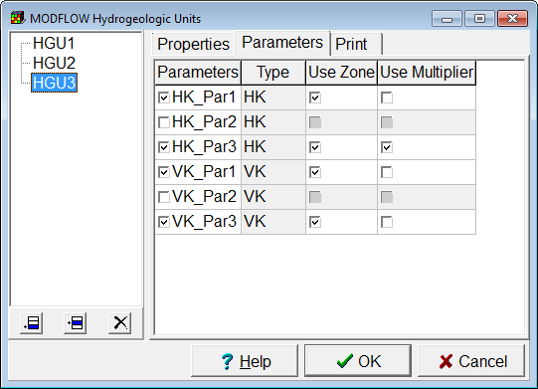
HUF Parameters are associated with HUF Units

Slide 9
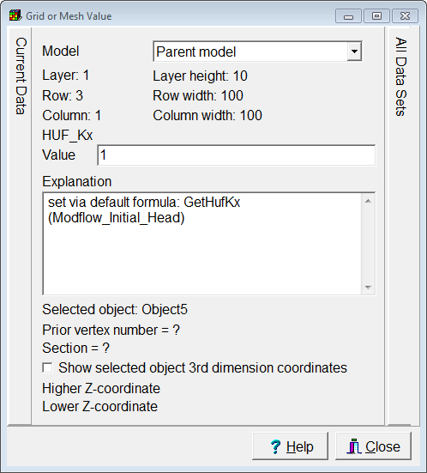
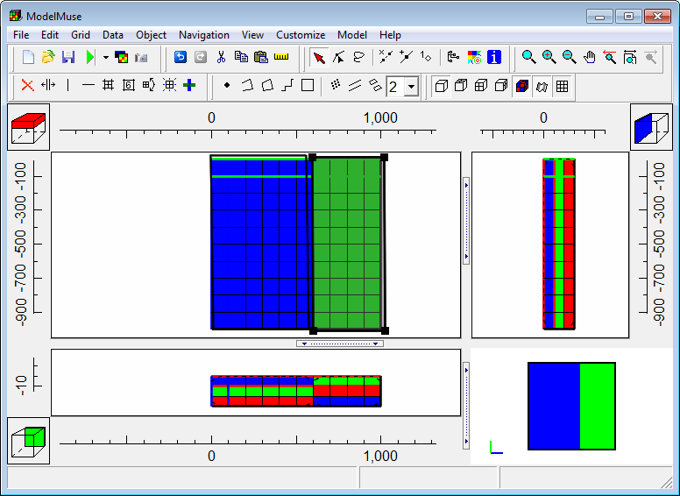
There are Optional Data Sets for Visualizing HUF Data

Slide 10
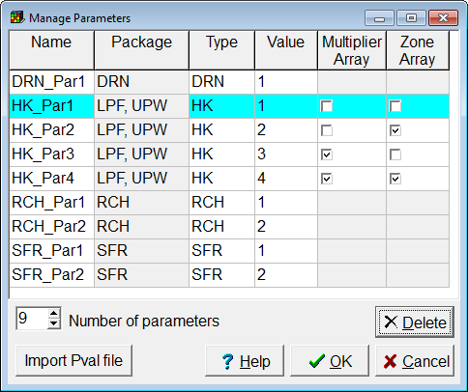
The Manage Parameters Dialog Box Can be Used to Edit Parameters

